Slide 2


Project DEMO
Visual Studio Code

Slide 3

Project DEMO

Slide 4
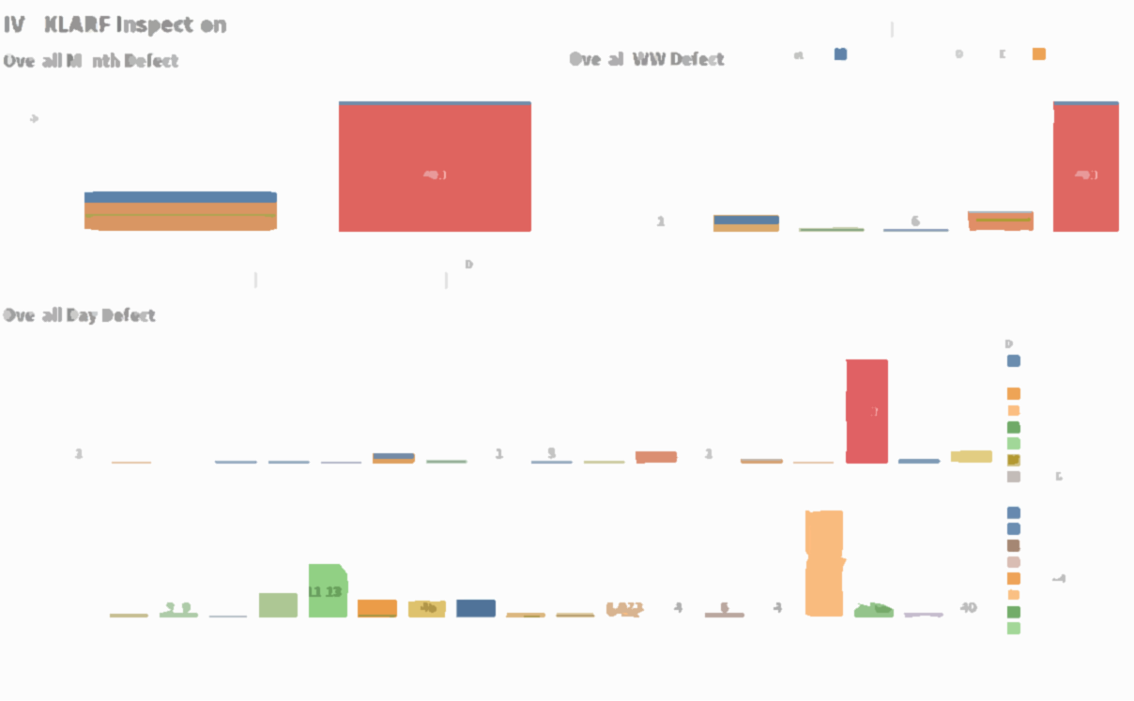
File Conversion with Data Analytics
How to convert a text file into a proper dataset ? How to visualize the data for RDA?

Slide 5
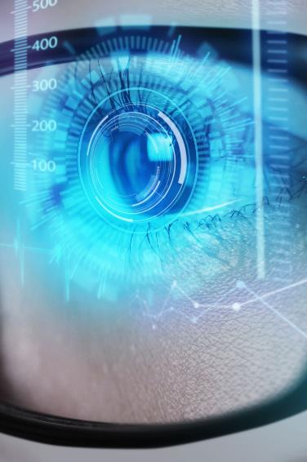
RDA Problem
NO Analysis
Impractical
No Tracking
Engineers are relying on text files and images to conduct data analysis on strip level
Data is limited to strip level with hundreds of lines of text. Analysis is a pain to do and takes over 20 mins for a single strip
Data has no representation or visualization to be tracked. Defect count is impossible to analyze against trends and location.
Limited sharing
Data and images only available to Metro Team, Stakeholders are unable to verify data and defects personally.

Slide 6
Current Inspection
150000 -180000
Date
30000 – 36000
Device
5000 – 6000++
Machine
1000 – 1200 ++
Lot
100 - 120
Strip
1-5
Defect
1
Die

Slide 7





Project Scope
File Conversion
Defect Mapping
Data Visualization
Automated Updates
Create a program to convert unreadable text files to readable csv files
Map out defect locations on the strip using an index dimensions
Present findings and data in appropriate graphs and visualizations
Update stakeholders and engineers of findings using automated emailing service

Slide 8




ATI Data file convertor +Dashboard
File Convertor
Graphics & Visuals
Python is a versatile programming language, has wide range of libraries for data analytics. Python handle the events and automation.
Tableau is a visual analytics platform with server integration to drive data-driven solutions. Tableau will be used to visualize data and run queries
Image viewing
Webpage & Server
Python offers many web framework API for web integration and server-side computation. Python will handle the backend operation on server.
HTML & CSS is used for many webpages and application for frontend application. HTML & CSS will handle frontend with JavaScript

Slide 9
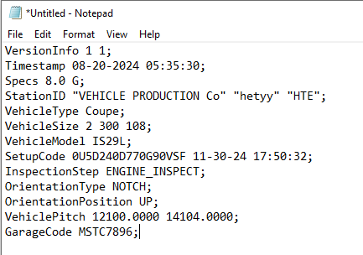

Python steps
Read each line, store in a library and checks its line for a certain string
1
2
A line is selected, split into individual strings and striped.
3
The final string would be the desired data for this dataset.

Slide 10
F
L
O
W
C
H
A
R
T
Start
Open TIF file
Separate Images
Open .001 file
Find TIF file
Update data with paths
True
If New File
Extract file info
Process Data lines
Check for dups
False
Find ‘Line’
Record Data lines
Combine CSV data
Watch for new files
Extract Strip Info
Find ‘Line2’
Save CSV
Schedule hourly task

Slide 11
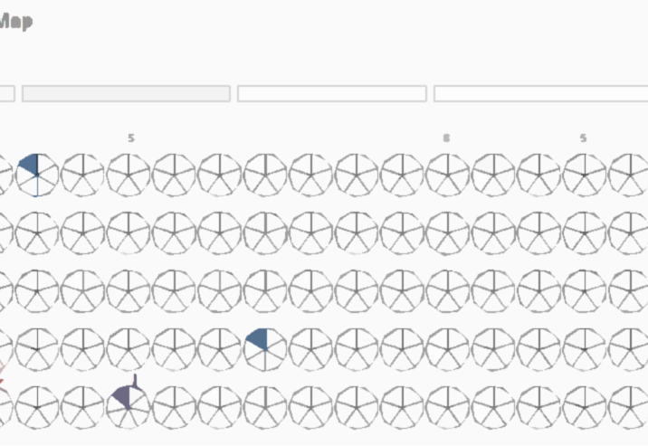
Tableau Dashboard
Defect Strip Mapping
Defect Count Tracking

Slide 12


Testing & Improvements
How I improved the application?
User Feedback
Continuous experimenting
PowerPoint slides
Virtual Machine
Regularly meetings with team, providing updates and receiving feedback. Tailored application to the needs of the team.
Repeated testing with different samples and lots to test reliability of application.
Created documentation and PowerPoint slides to teach users how to operate the application.
Backend python script will be running on a virtual machine to allow access across network

Slide 13




Additional Projects
TIFF Extractor
Panelist
Flask API​​
Server analytics
Extract specific frames from TIFF
Panelist for Internship sharing to SP Students
Server website for centralized use
Tracking traffic and usage across the API​

Slide 14
Project Resources
Software
Hardware
Additional
Python
HTML & CSS
Tableau
Visual Studios IDE
No Additional Hardware
​
Network Server
Virtual Machine
Generic User
​

Slide 15

Project Outcome
How does Micron benefit?

Slide 16



Project Benefits
Automate
Save Cost
Zero Defect
Zero Waste
Reducing man hours spent and workload of both engineers and technicians.
Increased operational efficiency.
Lower Input + Higher Output = Higher Yield
Predict potential areas of failure. Reduce probability of defects

Slide 17
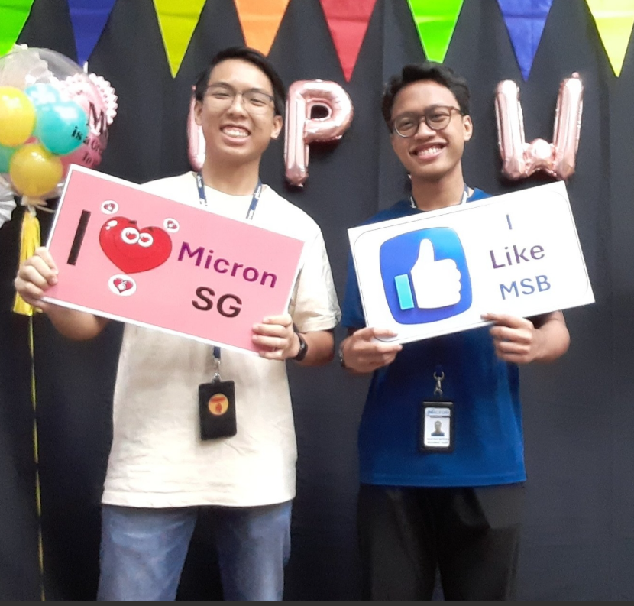
Project Impacts
further RDA analysis
Expedite evaluation process

Slide 18
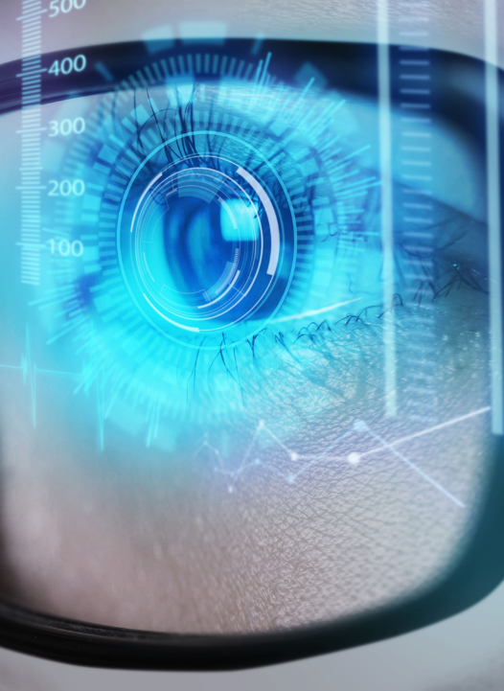
Company Improvements
 | before | After | Saved | Remarks
Underfill Analysis (Die Bleeding) | 20mins | 3mins | -85%​ | Automated + Specific+ Upscaled
Underfill Analysis (Strip Bleeding) | 20mins​ | 5mins | -75% | Upscaled​ +Specific
Strip Defect Mapping | Strip Level​ | Full Coverage | - | Automated for all lots​
Defect Tracking | Strip Level​ | Full Coverage | -​ | Tracking over Time​
Defect Viewing | 10-15mins​ | Immediate​ | -100% | Direct Viewing​
Emailing | ​5mins | ​Immediate | ​-100% | Automated Updates​
File Conversion | Single File 15mins | All Immediate​ | -100% | ​Automated Conversion
Server Webpage | 30secs | 10secs | -66.66% | 3-5 clicks to 1 click
Data Protection | Unprotected Server | Protected Server |  | Encrypt data and secure communication
TIFF Extractor | 5mins | Immediate | -100% | Specific + Quick
Total Time Saved | New + Full automation of file conversion, defect tracking and mapping 20mins/strip saved for file conversion ​32mins/lot saved for underfill analysis Automated updates weekly

Slide 19
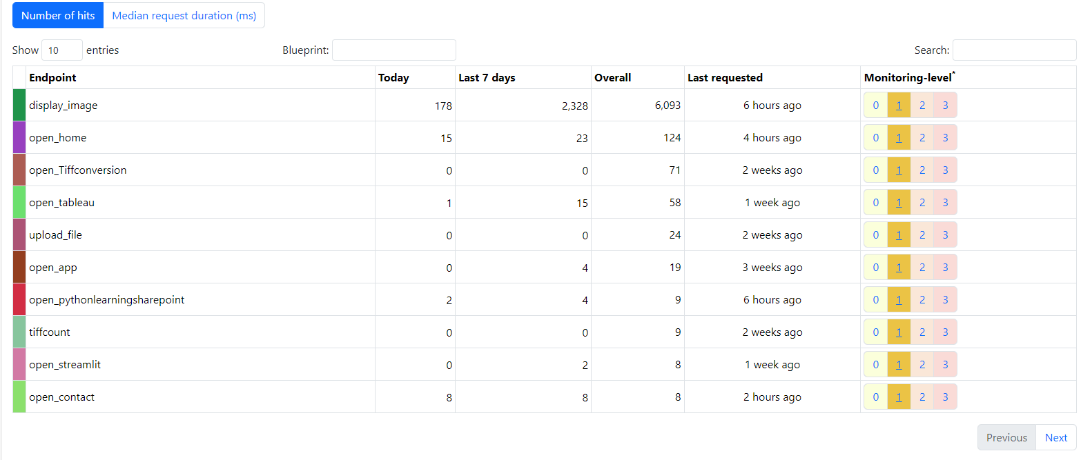
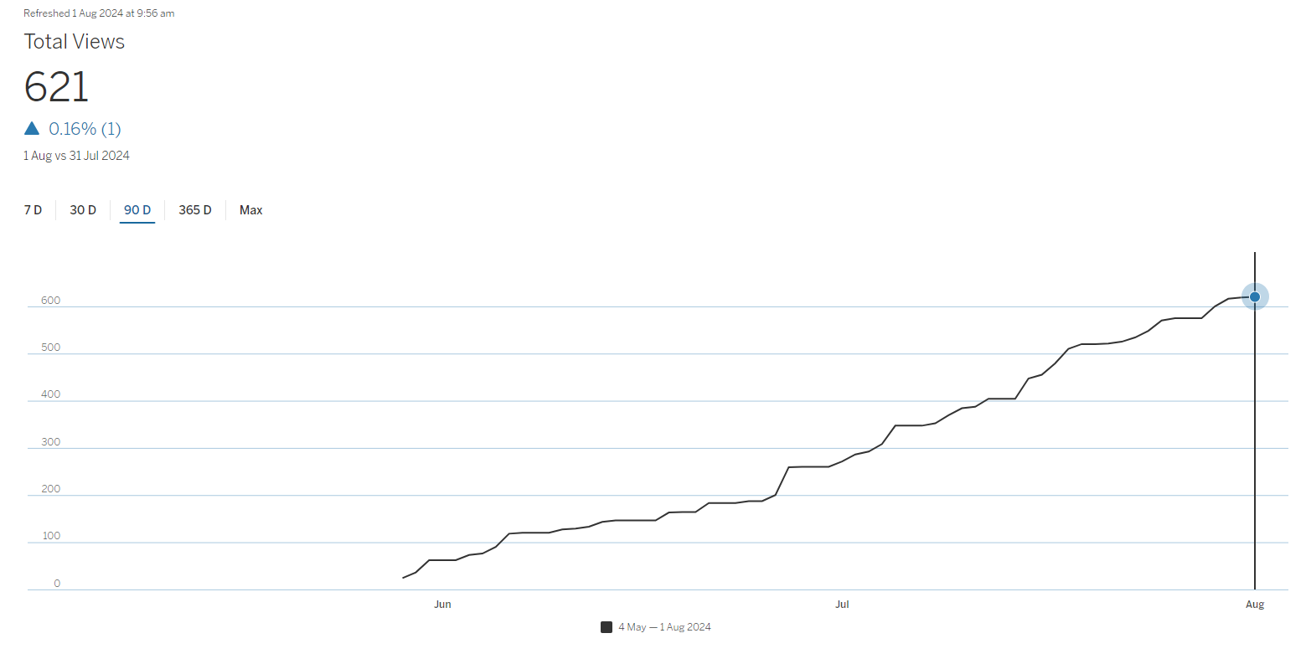





Company Improvements
Over 50 Man Hours Saved Daily!
Over 2248 Man Hours saved since 17 July
Over 621 Views on Dashboard
Over 2900 Files Converted (725 Man Hours)
~ 30 Engineers and Technicians Users
~ 100 Engineers and Technicians Impacted
Future Implementation to other machines (x 1-2)
Possible Implementation to other backend sites (8 Sites)

Slide 20
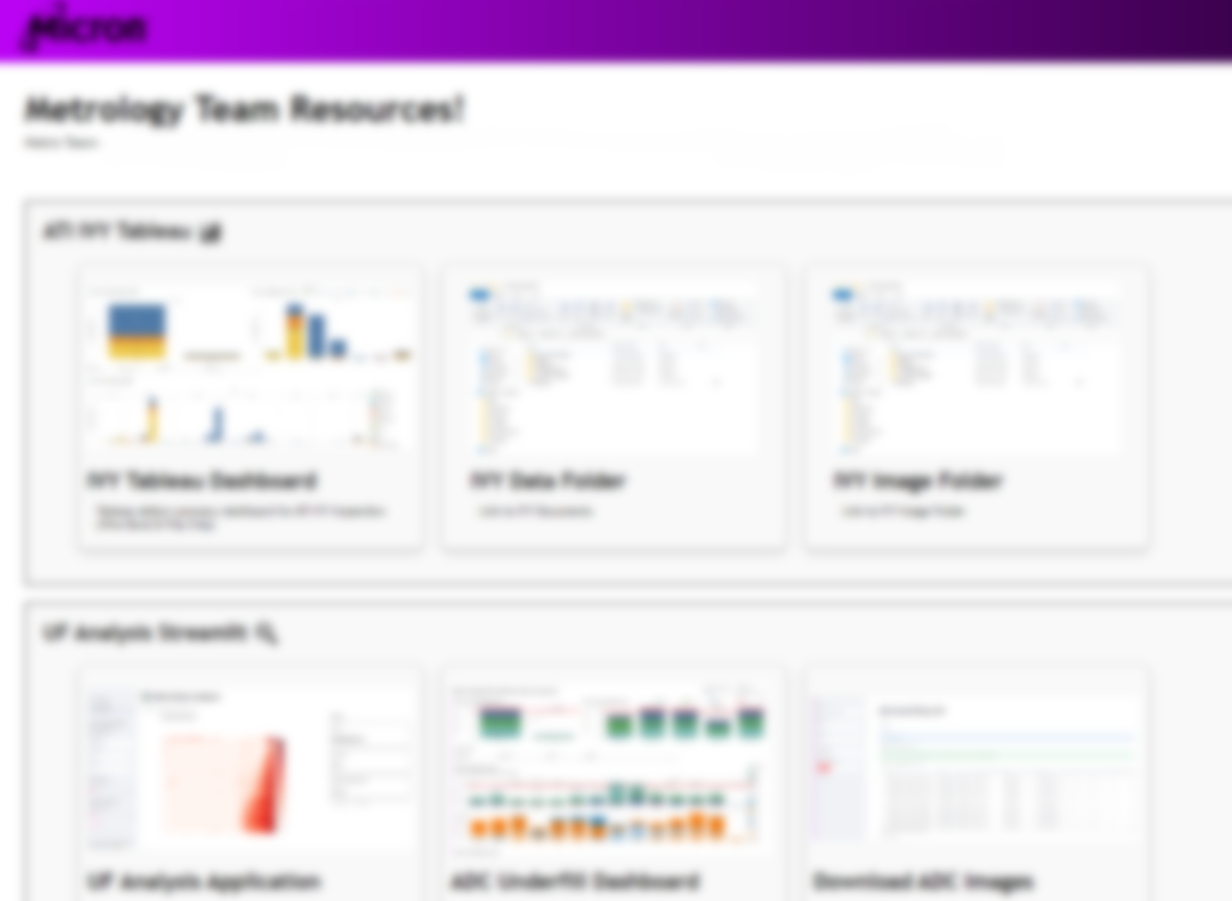
Outcome
Webpage
All links and materials related to my projects are on server webpage for easier viewing
Virtual machine
All codes and programs are running seamlessly on a virtual machine, reducing need for human intervention
Flask API​
All server transactions are running on HTTPS and SSL for secure communications and encryption.

